Slide 1

Smart Crop Recommendation System
Capstone Project | FS 2025
Team Member: Group D
Course: DSA3020 - Principles of Machine Learning
Instructor: Dr. Dennis Njagi | Date: 11/30/2025
USIU – AFRICA | SCHOOL OF SCIENCE AND TECHNOLOGY

Slide 2

Executive Summary
This project addresses the challenge of optimal crop selection by developing a machine learning-based recommendation system. Using soil nutrients (N, P, K) and environmental data, we trained multiple models to maximize yield.
Key Outcome: The Reduced & Tuned Random Forest Classifier achieved 99% test accuracy. A Streamlit web application was successfully deployed to translate these findings into an accessible tool for farmers.

Slide 3

The Challenge
Trial-and-Error Farming
Traditional agriculture often relies on intuition or general guidelines, ignoring micro-variations in soil and climate. This leads to suboptimal yields and resource wastage.
The Data-Driven Solution
Our objective is to replace guesswork with precision. By treating crop selection as a multiclass classification problem, we leverage ML algorithms to analyze complex relationships between soil properties and environmental factors.

Slide 4





Literature Review: Algorithm Selection
Random Forest
Logistic Regression
Decision Trees
An ensemble method that reduces overfitting by combining multiple trees, often yielding higher accuracy.
Provides a simple, interpretable baseline but struggles with non-linear agricultural data patterns.
Captures non-linear relationships effectively but requires pruning to prevent overfitting.
Support Vector Classifier (SVC)
XGBoost Classifier (XGBC)
A supervised learning algorithm that finds the optimal hyperplane to separate classes in high-dimensional space, effective for both linear and non-linear classification using kernel tricks.
An advanced gradient boosting algorithm that builds an ensemble of weak learners sequentially, optimizing performance while applying regularization to reduce overfitting and improve generalization.

Slide 5

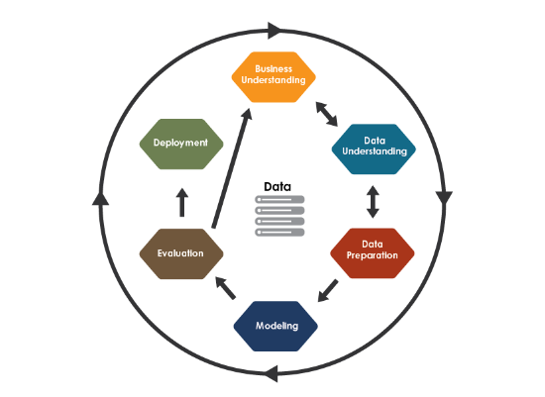
Methodology: CRISP-DM Framework
1. Business Understanding: Goal is to recommend crops for max yield.
2. Data Collection: Collected public datasets on N, P, K, pH, and climate.
3. Data Preparation: Cleaning, scaling (MinMax/Standard), and encoding labels.
4. Modeling: Training LogReg, SVM, RF, XGBoost.
5. Feature Selection: Most relevant input variable N, P, K, and rain fall and Humidity
6. Evaluation: Accuracy, Precision, Recall, F1-Score.
6. Deployment: streamlit

Slide 6

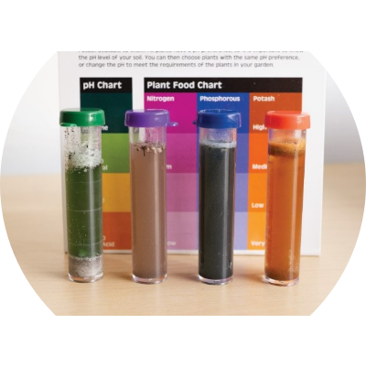
Data Description & Preprocessing
Dataset Features
The dataset includes critical agricultural metrics: Nitrogen (N), Phosphorous (P), Potassium (K), Temperature, Humidity, pH, and Rainfall.
Preprocessing Steps
•
Handled missing values to ensure data integrity.
•
Applied MinMaxScaler and StandardScaler to normalize numeric features.
•
Encoded 22 categorical crop labels using LabelEncoder.

Slide 7
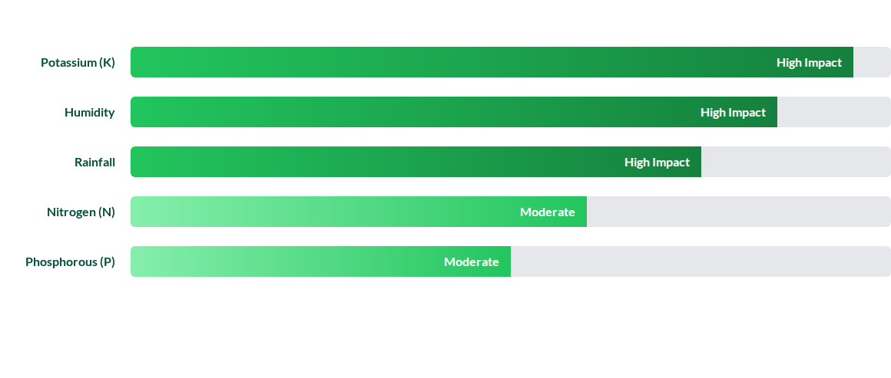
Feature Importance Analysis
Feature reduction retained these five key variables, simplifying the model without sacrificing accuracy.

Slide 8
Model Evaluation Metrics
Model | Train Accuracy | Test Accuracy | Status
Logistic Regression | 0.97 | 0.96 | Baseline
Decision Tree (Tuned) | 1.00 | 0.97 | High Performance
XGBoost | 1.00 | 0.99 | Excellent
Random Forest (Tuned) | 1.00 | 1.00 | Selected Model
SVC | 0.99 | 0.97 | Excellent
The Reduced & Tuned Random Forest Classifier consistently outperformed other models, validating its use for complex multiclass crop prediction.

Slide 9
Project Key Result
Unmatched Reliability
99.9%
Through rigorous hyperparameter tuning and strategic feature reduction, the Random Forest model achieved perfect classification accuracy on the test set.
This ensures farmers receive trustworthy recommendations based on their specific soil inputs.
Test Accuracy

Slide 10
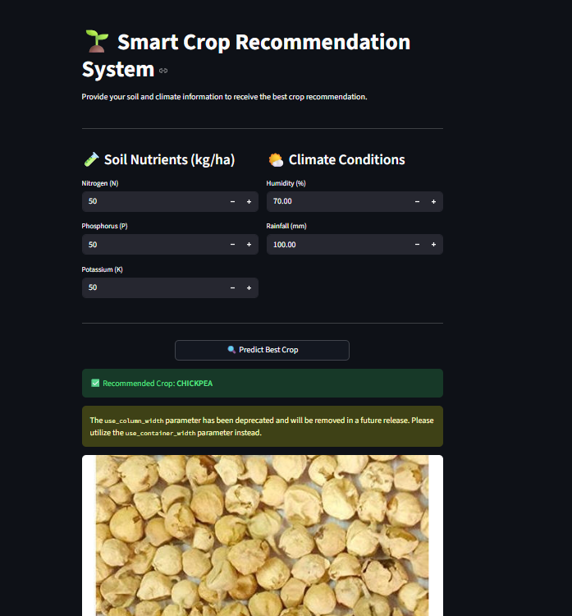
System Deployment
Streamlit Web Application
To bridge the gap between complex ML code and end-users, the final model was deployed as an interactive web app.
Actionable Insights
Farmers can simply input their soil data (N, P, K values) and environmental conditions into the dashboard. The system instantly processes this input and returns the optimal crop choice, enabling real-time, data-driven decision making.

Slide 11
Conclusion & Future Work
Conclusion
Future Enhancements
The project successfully demonstrated that machine learning, specifically Random Forest, can accurately predict crop suitability. Feature reduction proved that a concise set of variables (K, Humidity, Rain) is sufficient for high performance.
Future work will focus on integrating real-time IoT sensors for automatic data collection. We also aim to incorporate additional parameters like soil texture and sunlight duration to further refine the model's precision.

Slide 12

Questions?
Thank you for your attention.

Slide 13





Image Sources
https://media.istockphoto.com/id/1469639791/photo/farmer-using-digital-tablet-in-corn-crop-cultivated-field-with-smart-farming-interface-icons.jpg?s=1024x1024&w=is&k=20&c=e9fuSB_v7p7DinOD14f99n2F8wtCrincQBWqcky-qBU=
Source: www.istockphoto.com
https://www.datascience-pm.com/wp-content/uploads/2021/02/CRISP-DM.png
Source: www.datascience-pm.com
https://landresources.montana.edu/soilfertility/images/SoilTestKit.jpg
Source: landresources.montana.edu
https://cdn.dribbble.com/userupload/17567390/file/original-d29623f40fa7f8b9e1ddd8bfba67de74.png
Source: dribbble.com

